Slide 1
Pandas
Presentations
Michael McBride, Bretton Maybee, Gunjan Batth, Cindy Ngo, Lorena Arse

Slide 2
Agenda
Research Question
Methodology & Data Sources
Findings & Analysis
Conclusions

Slide 3
Research Question
COVID-19 Paradox: Has COVID-19 had a significant impact on Mortality Rates compared to years prior? How has COVID-19 affected different areas in the United States?
Notes:
Flash Different articles questioning if mortality rates are higher in 2020 due to COVID-19

Slide 4
Methodology & Sources
Methodology
Pre-COVID Mortality Rates
2020 Mortality Rates
COVID-19 affects in different areas
Source: Aggregated Mortality data from 1999-2018 from the CDC Wonder.
Obtained Overall death rate (Total Deaths/Total Population
Broken up by State, Age & Race
Source: CDC COVID Deaths in the US.
Total Death rate in 2020 (Including Covid deaths)
Broken down by State, Age & Race
Sources: CDC Excess Deaths Associated by COVID. NY TImes COVID-19 Data
Which areas in the US were affected heavily.

Slide 5
Data Sources & Analysis
Data Sources, what it looks like and code demo along with analysis.
Notes:
Flash Different articles questioning if mortality rates are higher in 2020 due to COVID-19

Slide 6
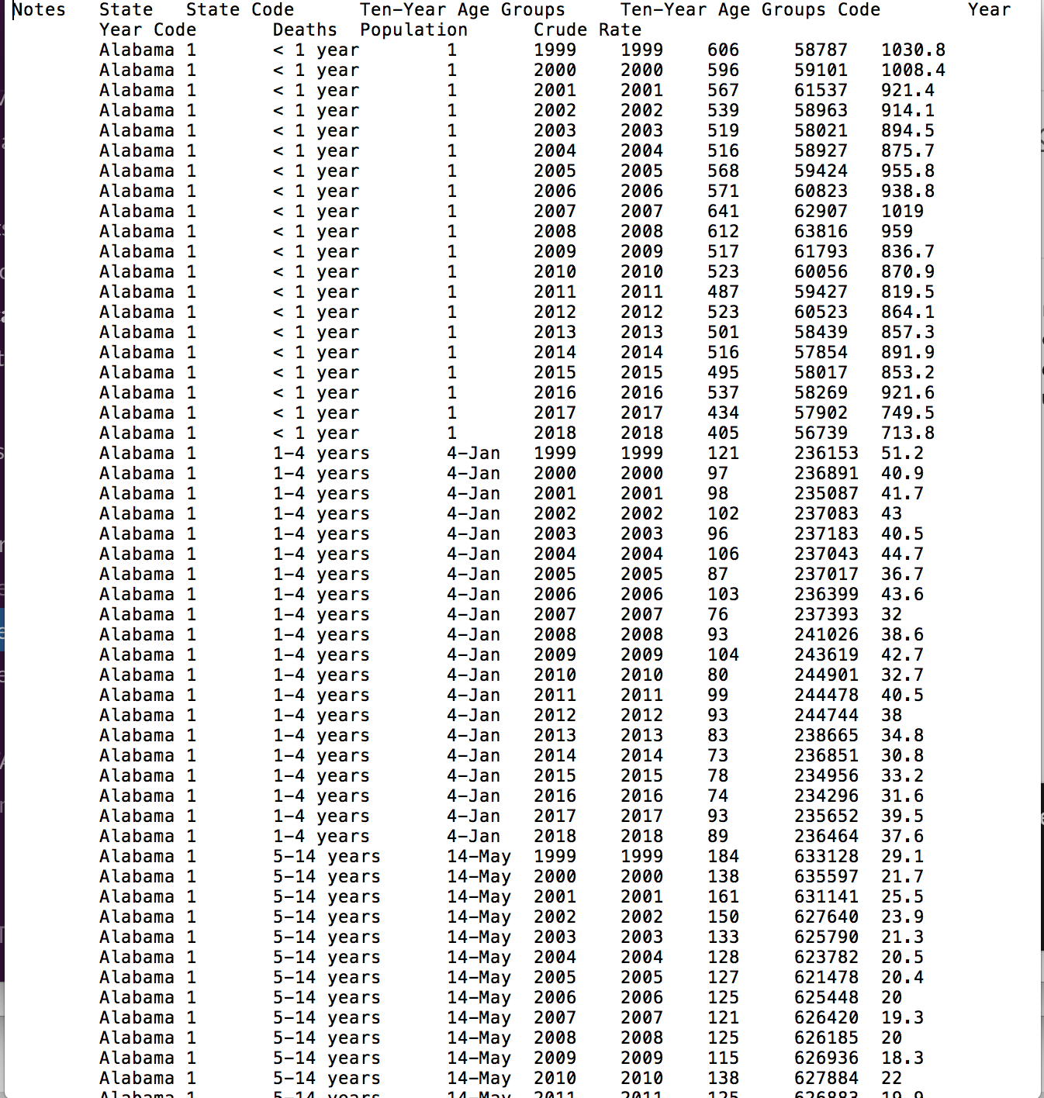
Pre-COVID Data
Source: Mortality for
Obtained Overall death rate (Total Deaths/Total Population)
Broken up by State, Age & Race
Had to merge datasets
Notes:
Gunjuan

Slide 7
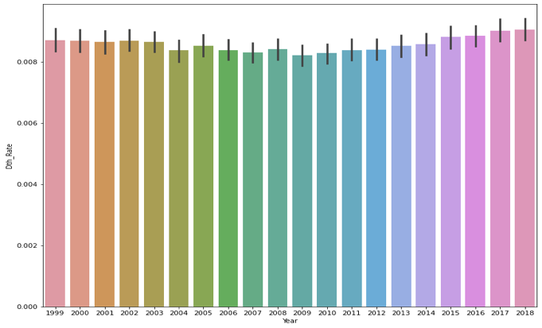
Death Rates Over Last 10 years
Notes:
Gunjan

Slide 8
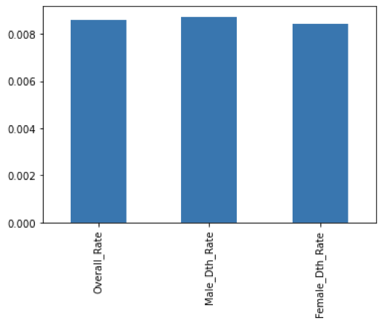
Death Rates by Sex
Notes:
Gunjan

Slide 9
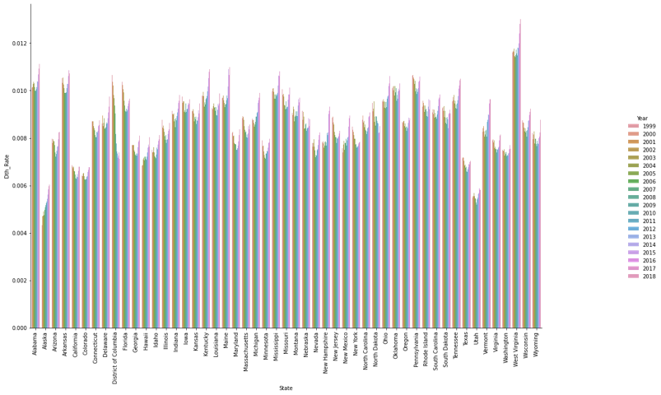
Death Rate by State & Years
Notes:
Gunjan

Slide 10
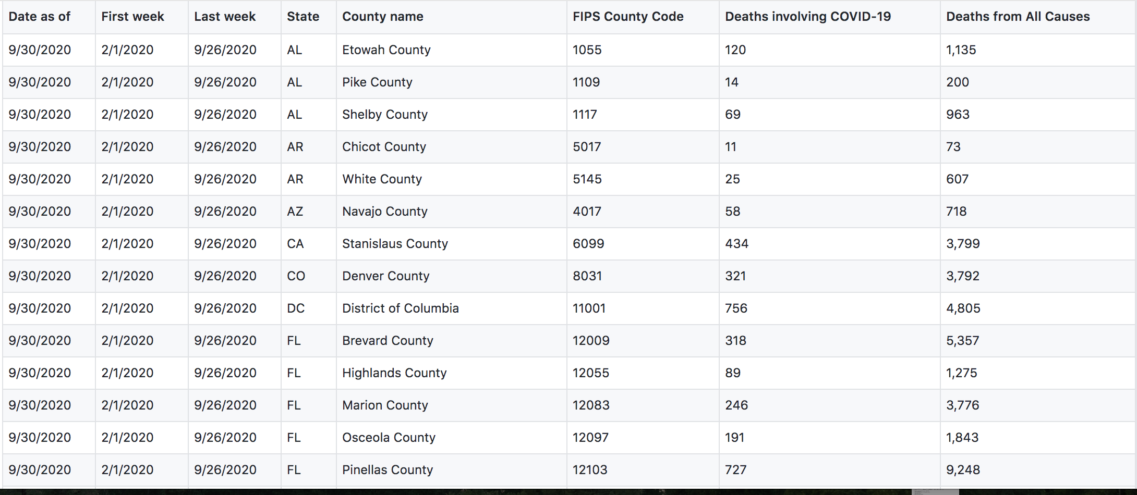
2020 Death Rates Data
Source: CDC COVID deaths in the US
Had to Group By States then add total.
Merge total deaths with total population to get death rate
Notes:
Lorena

Slide 11
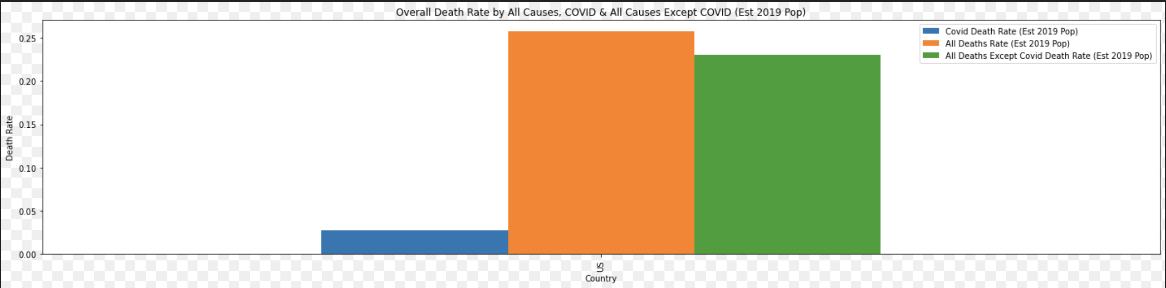
Overall Death Rate
Notes:
Lorena

Slide 12
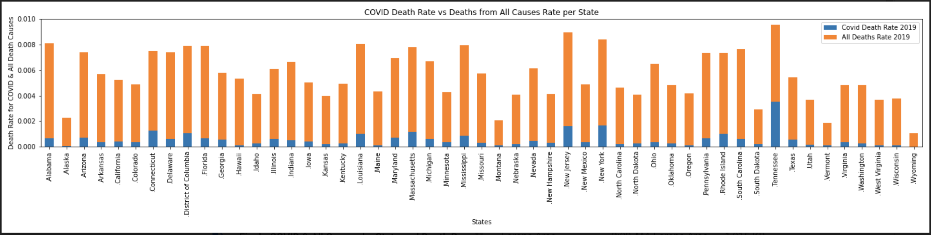
COVID Death Rate per State
Notes:
Lorena

Slide 13
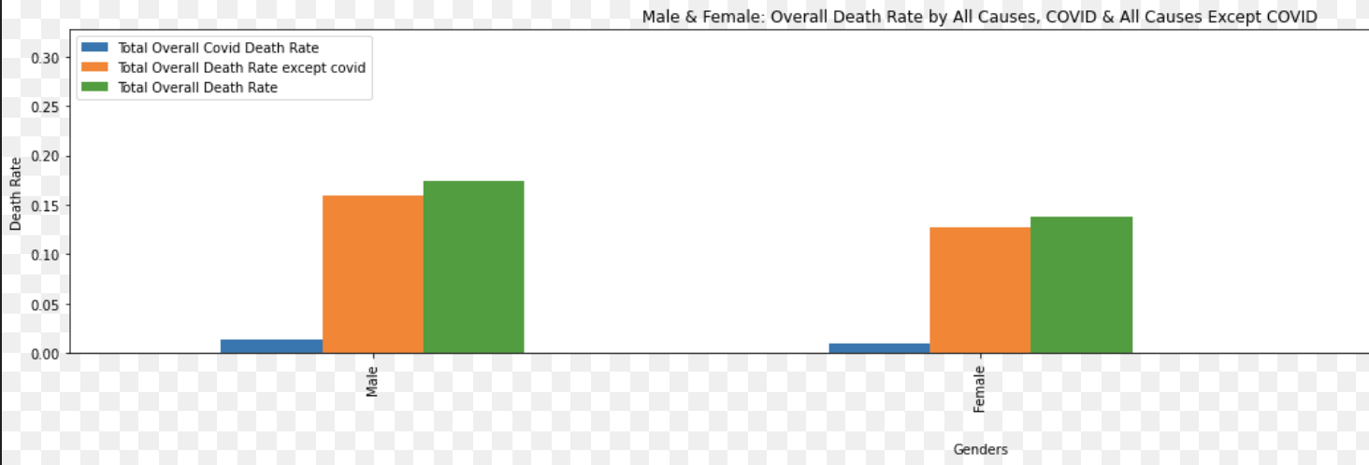
Death Rate by Age
Notes:
Lorena

Slide 14
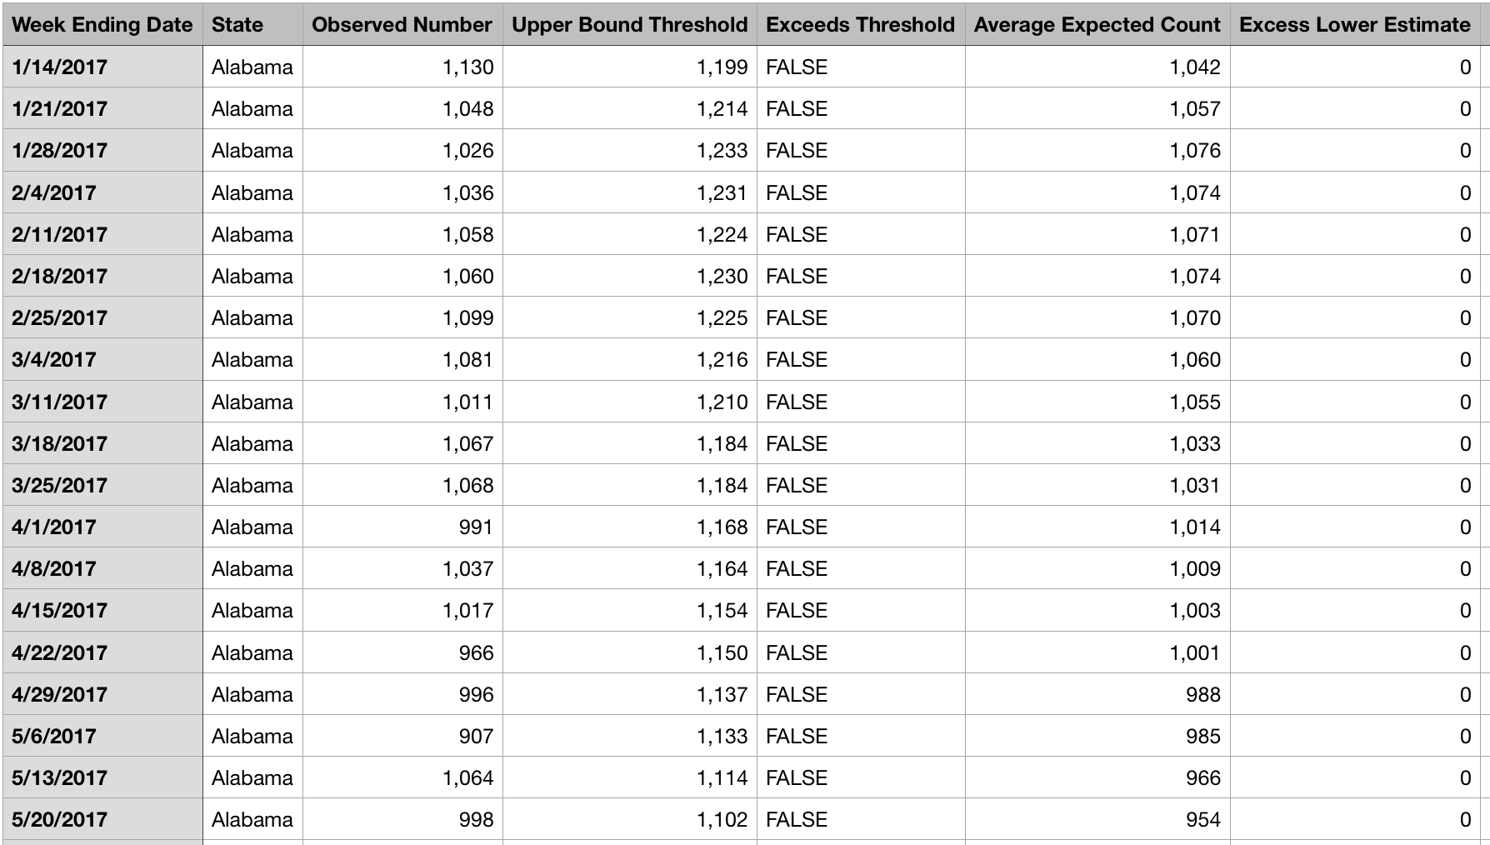
Excess COVID Deaths
Compared expected deaths vs actual deaths from COVID
Did an analysis on which state was affected the most

Slide 15
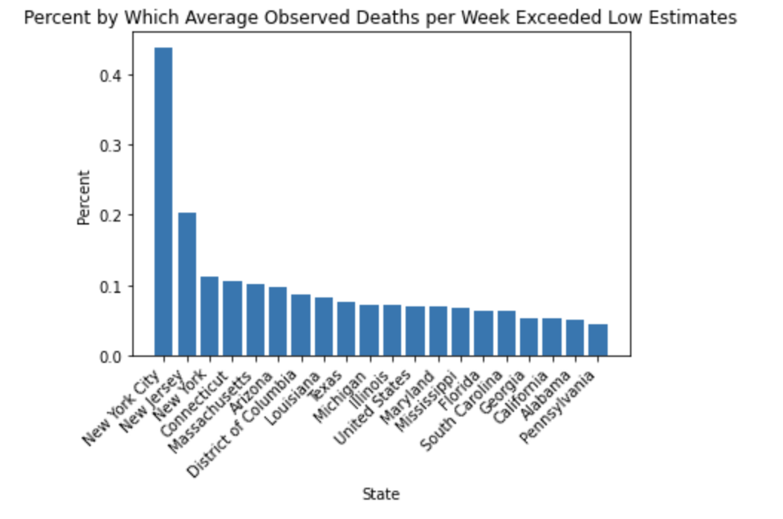
Excess Deaths by States

Slide 16
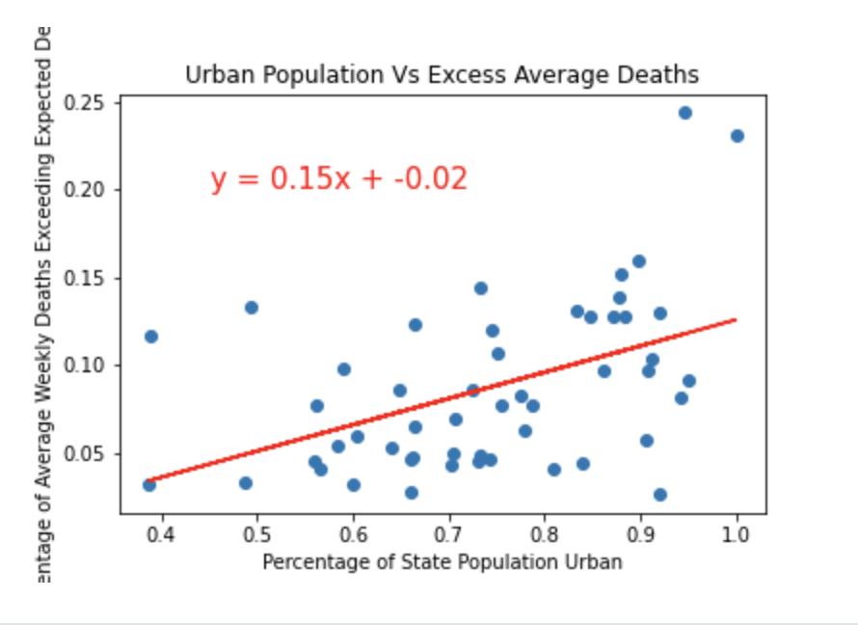
Urban Population vs Excess Deaths

Slide 17
Conclusions

Slide 18
Overall death rates were impacted due to COVID-19 as they increased from its 10 year average
Death Rates are higher with men
COVID Death Rates & Historical death rates are similar among age groups & states
Excess Deaths are affected by population distribution
Notes:
Michael

